Slide 1

Université de Mostaganem — Dr. Madani BELACEL
TIC COURSE 08
The World Wide Web
Dr. BELACEL Madani
Année universitaire 2026-2027 / Academic Year 2026-2027
Université de Mostaganem - Département Mathématiques et Informatique

Slide 2
Université de Mostaganem — Dr. Madani BELACEL
Course Outline
▪ 1. Web Is Not the Internet
▪ 2. Core Concepts
▪ 3. Web Languages
▪ 4. Hosting and Publishing
▪ 5. From Web 1.0 to Web 3.0
▪ 6. Effective Browsing
▪ 7. Content Quality and Reliability

Slide 3
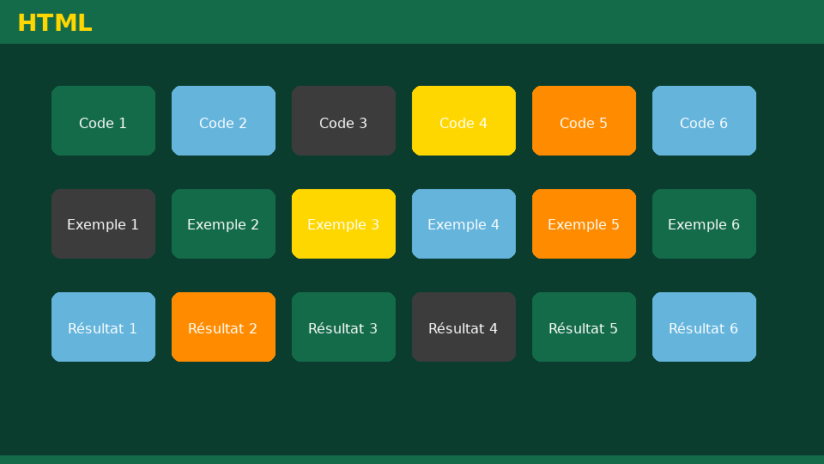
Université de Mostaganem — Dr. Madani BELACEL
Section 1
Web Is Not the Internet

Slide 4
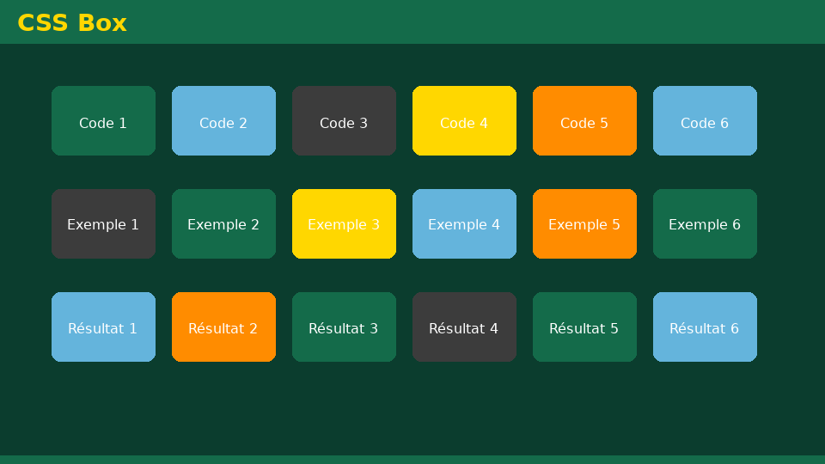
Université de Mostaganem — Dr. Madani BELACEL
1 - Web Is Not the Internet
▪ The Internet = the worldwide network infrastructure.
▪ The Web = a service running ON the Internet (hypertext).
▪ Other services: email, FTP, instant messaging.
▪ Invented by Tim Berners-Lee at CERN in 1989-1991.

Slide 5

Université de Mostaganem — Dr. Madani BELACEL
Section 2
Core Concepts

Slide 6

Université de Mostaganem — Dr. Madani BELACEL
2 - Core Concepts
▪ Website: pages connected by hyperlinks.
▪ URL: address of a resource (protocol://domain/path).
▪ HTTP/HTTPS: protocol for transferring web pages.
▪ Client (browser) / web server: request-response model.

Slide 7

Université de Mostaganem — Dr. Madani BELACEL
Section 3
Web Languages

Slide 8

Université de Mostaganem — Dr. Madani BELACEL
3 - Web Languages
▪ HTML: page structure and content.
▪ CSS: styling and visual design.
▪ JavaScript: browser-side interactivity.
▪ PHP, Python, ASP.NET: server-side programming.

Slide 9

Université de Mostaganem — Dr. Madani BELACEL
Section 4
Hosting and Publishing

Slide 10
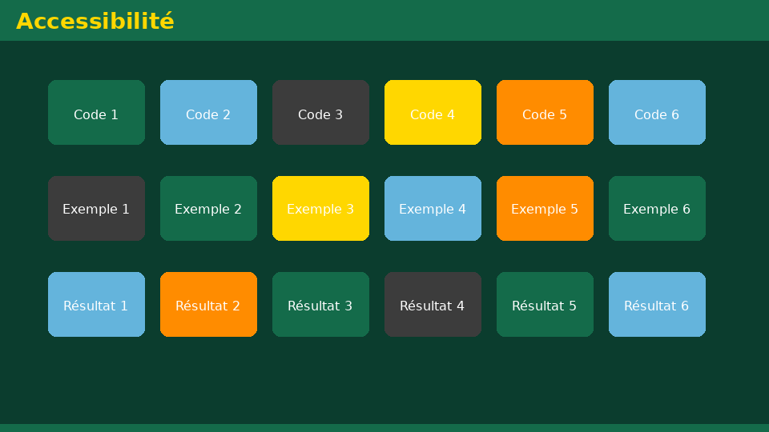
Université de Mostaganem — Dr. Madani BELACEL
4 - Hosting and Publishing
▪ Domain name: registration (.dz, .com, .org...).
▪ Hoster: always-on server available 24/7.
▪ File transfer via FTP/SFTP.
▪ CMS: WordPress, Joomla to build without coding.

Slide 11

Université de Mostaganem — Dr. Madani BELACEL
Section 5
From Web 1.0 to Web 3.0

Slide 12

Université de Mostaganem — Dr. Madani BELACEL
5 - From Web 1.0 to Web 3.0
▪ Web 1.0: static read-only pages.
▪ Web 2.0: participative, social networks, wikis, blogs.
▪ Semantic Web (3.0): structured data, AI.
▪ Rich applications: SPAs, cloud, real time.

Slide 13

Université de Mostaganem — Dr. Madani BELACEL
Section 6
Effective Browsing

Slide 14
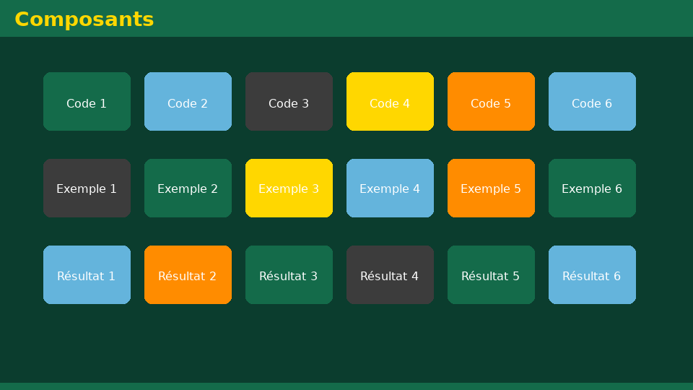
Université de Mostaganem — Dr. Madani BELACEL
6 - Effective Browsing
▪ Tabs and bookmarks to manage multiple sources.
▪ Advanced search and filters.
▪ Useful extensions: ad blocker, translator.
▪ Private mode and clearing history.

Slide 15
Université de Mostaganem — Dr. Madani BELACEL
Section 7
Content Quality and Reliability

Slide 16
Université de Mostaganem — Dr. Madani BELACEL
7 - Content Quality and Reliability
▪ Check the author, date and source of the site.
▪ Cross-check information with several references.
▪ Watch out for fake news.
▪ Cite your sources: respect copyright.

Slide 17
Université de Mostaganem — Dr. Madani BELACEL
Practical Interest
▪ Build your own professional website or online portfolio.
▪ Use the Web as a scientific monitoring tool.
▪ Understand what happens behind every click.
▪ Essential foundation for learning web development.

Slide 18
Université de Mostaganem — Dr. Madani BELACEL
Self-Assessment (MCQ)
1. Who invented the Web?
a) Bill Gates
b) Tim Berners-Lee
c) Steve Jobs
2. HTML is used to:
a) Style the page
b) Structure content
c) Manage the database
3. Web 2.0 is characterized by:
a) Static pages
b) User participation
c) No hyperlinks

Slide 19
Université de Mostaganem — Dr. Madani BELACEL
Conclusion
▪ The Web is the most used Internet service.
▪ URL, HTTP, HTML/CSS form its technical foundation.
▪ Critical thinking remains essential with online information.
▪ Next course: computer networks.

Slide 20
Université de Mostaganem — Dr. Madani BELACEL
References
- T. Berners-Lee, "Weaving the Web", HarperBusiness.
- MDN Web Docs (developer.mozilla.org).
- ICT Course materials, University of Mostaganem.
- www.w3.org - the Web Consortium.

Slide 21
Université de Mostaganem — Dr. Madani BELACEL
Thank you for your attention!
Questions?
Dr. BELACEL Madani

